Slide 1
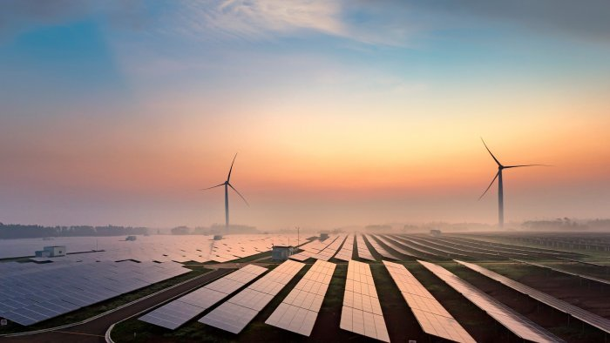

CleanMax
POWERING SUSTAINABILITY

Slide 2






Our Strengths
Started in 2011 with mission to be “sustainability partner” to private users
100% focus on Corporate and Industrial clientele since inception
Renewable Energy
Wind & Solar farms connected to:
a) Central grid (ISTS)
b) State grid (InSTS)
Green Credits
REC (long term/ spot)
Virtual PPAs
Carbon credit trading
Pioneering Sustainability
Diversified Offerings
$855 million worth of assets as of June 2023 with capacity of 1.6 GW operational
No. 1 player since 2014 in the Indian Corporate and Industrial space
Breadth: 350+ clients, 600+ PPAs, 1,000 installations
Quality: 80%+ clients AA / AAA rated or MNC subsidiaries
Satisfaction: 70% clients repeat within a year
Largest C&I Player in Asia
Client First Culture
Well capitalized with $360 million equity from Brookfield (world’s no. 1 renewables investor)
67MW of new addition in FY23 across Thailand, UAE, Bahrain in rooftop
Supplying RECs across all major South and South-East Asian Economies
Robust Finances
Emerging Internationally
2

Slide 3





Our journey to market leadership
Pioneered the
Opex Model for Solar
Inception of
CleanMax
2011
2012
Commissioned TN’s first Open Access Solar farm
$35 Mn Investment by UKCI
Commissioned 1st Wind Farm
2017
Commissioned 400 MW Hybrid Project;
$360 Mn investment by Brookfield
2019
Crossed 1.2 GW Capacity
2020
2022
2023
2014
1 MWp Attained
2015
Commissioned a
4 MWp Onsite solar plant (India’s largest)
2017
$70 Mn investment by Warburg Pincus & IFC
2018
Expanded to Dubai & Thailand
2021
$225 Mn investment by Augment Infrastructure
Phase 1
Phase 2
Phase 3
3

Slide 4




Our project development pipeline
State | Capacity | Type | COD
Maharashtra | 30 MWp | Solar | 2022
 | 230 MW | Solar | 2024*
 | 100 MW | Wind | 2024*
Gujarat | 65 MW | Wind | 2021
 | 450 MW | Hybrid | June 2023
 | 250 MW | Hybrid | 2024*
Tamil Nadu | 30 MWp | Solar | 2017
 | 20+ MWp | Solar | 2021
 | 100 MW | Solar | Dec 2023*
Karnataka | 330 MWp | Solar | 2018
 | 52 MW | Hybrid | 2021
 | 75 MW | Hybrid | 2022
 | 300MW | Hybrid | Dec 2023*
Wind Solar Hybrid
Standalone Solar
Existing Projects
*currently under construction
4

Slide 5






Our key clientele
49.5 MW Wind open access in Karnataka
8 on-site projects with a total capacity of 14 MWp
10.8 MW Wind + 8 MWp Solar in Gujarat
Opted to invest 100% in the project
33 MW Wind + 28.05 MWp Solar Hybrid
Offset: 30% of global requirement
4.5 MW Wind + 3.8 MWp Solar Hybrid for it’s Sarigam facility.
Opted for a 0 investment model
Offset: 45%
5.4 MW Wind + 4.5 MWp Solar Hybrid for it’s Indrad facility in Gujarat
Offset: 40%
2.7 MW Wind + 19 MWp of Solar capacity in Karnataka
Offset: 75%

Slide 6




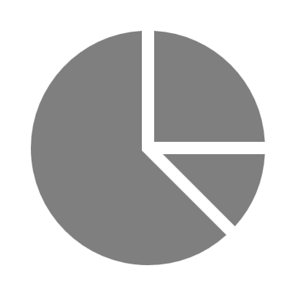


#Ref001: Savings of ~#Ref002 Cr/annum over 25 years
Our Offering
Group Captive Structure
Payment for the electricity consumed
#Ref003 MW Wind + #Ref004 MWp Solar
Total Savings
INR #Ref008 Cr
#Ref012
Generation
#Ref005 kWh
Landed Tariff
INR #Ref009 /kWh*
CleanMax
#Ref013
#Ref006 Offset
Investment
INR #Ref010 Cr
Timeline
#Ref007
Break Even
#Ref011 months
*At a Tariff of INR #Ref014 /kWh

Slide 7








Details of our upcoming wind and solar projects in Maharashtra
Project Details - Solar
Project Details - Wind
Location : Ghatanji, Yavatmal
Capacity : 100 MWac (150 MWp)
Estimated CUF : 18.25%
Generation : 240,000 MWh/year
Transmission : STU (132 kV)
Location : Kolhapur
Capacity : 100 MWac
Estimated CUF : 39%
Generation : 340,000 MWh/year
Transmission : STU (110 kV)
- Connectivity Approved
- Land Acquired
- Expected COD by Oct ’24
- Connectivity Approved
- Land Acquisition in process
- Expected COD by Dec ’24
7

Slide 8
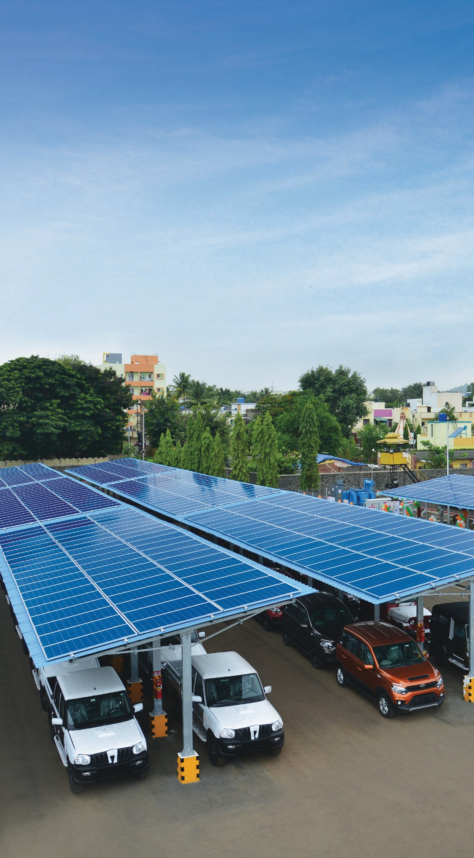
THANK YOU!
8

